Slide 1
Artificial Neural Networks
Threshold units
Gradient descent
Multilayer networks
Backpropagation
Hidden layer representations
Example: Face recognition
Advanced topics
CS 521 Machine Learning
Chapter 4 Artificial Neural Networks
1

Slide 2
Introduction
Neural network learning methods provide a robust approach to approximating real-valued, discrete-valued, and vector-valued target functions.
For certain types of problems, such as learning to interpret complex real-world sensor data, artificial neural networks are among the most effective learning methods currently known.
Can be used for learning to recognize handwritten characters (LeCun et al. 1989), learning to recognize spoken words (Lang et al. 1990), and learning to recognize faces.
CS 521 Machine Learning
Chapter 4 Artificial Neural Networks
2

Slide 3
Connectionist Models
Consider humans
Neuron switching time ~.001 second
Number of neurons ~10¹⁰
Connections per neuron ~10⁴⁻⁵
Scene recognition time ~.1 second
100 inference step does not seem like enough
must use lots of parallel computation!
Properties of artificial neural nets (ANNs):
Many neuron-like threshold switching units
Many weighted interconnections among units
Highly parallel, distributed process
Emphasis on tuning weights automatically
CS 521 Machine Learning
Chapter 4 Artificial Neural Networks
3

Slide 4
NEURAL NETWORK REPRESENTATIONS
Artificial neural networks are built out of a densely interconnected set of simple units, where each unit takes a number of real-valued inputs (possibly the outputs of other units) and produces a single real-valued output
There are many complexities to biological neural systems that are not modeled by ANNs, and many features of the ANNsare known to be inconsistent with biological systems
Ex: A prototypical example of ANN learning is
ALVINN.

Slide 5
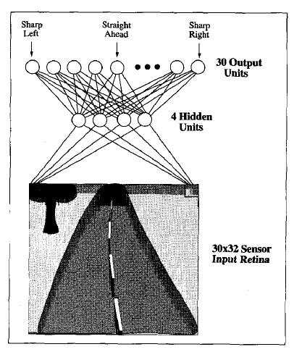

Slide 6
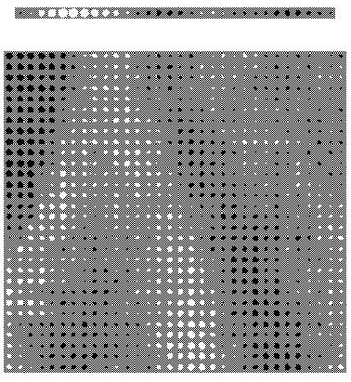
ALVINN drives 70 mph on highways
CS 521 Machine Learning
Chapter 4 Artificial Neural Networks
6

Slide 7
It uses a learned ANN to steer an autonomous vehicle driving at normal speeds on public highways.
The input to the neural network is a 30 x 32 grid of pixel intensities obtained from a forward-pointed camera mounted on the vehicle. The network output is the direction in which the vehicle is steered.
ANN is trained to mimic the observed steering commands of a human driving the vehicle for approximately 5 minutes.
ALVINN has used its learned networks to successfully drive at speeds up to 70 miles per hour and for distances of 90 miles on public highways.

Slide 8
When to Consider Neural Networks
Input is high-dimensional discrete or real-valued (e.g., raw sensor input)
Output is discrete or real valued
Output is a vector of values
Possibly noisy data
Long training times are acceptable.
Fast evaluation of the learned target function may be required.
Human readability of result is unimportant
Examples:
Speech phoneme recognition [Waibel]
Image classification [Kanade, Baluja, Rowley]
Financial prediction
CS 521 Machine Learning
Chapter 4 Artificial Neural Networks
8

Slide 9
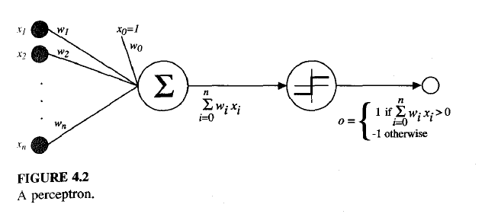
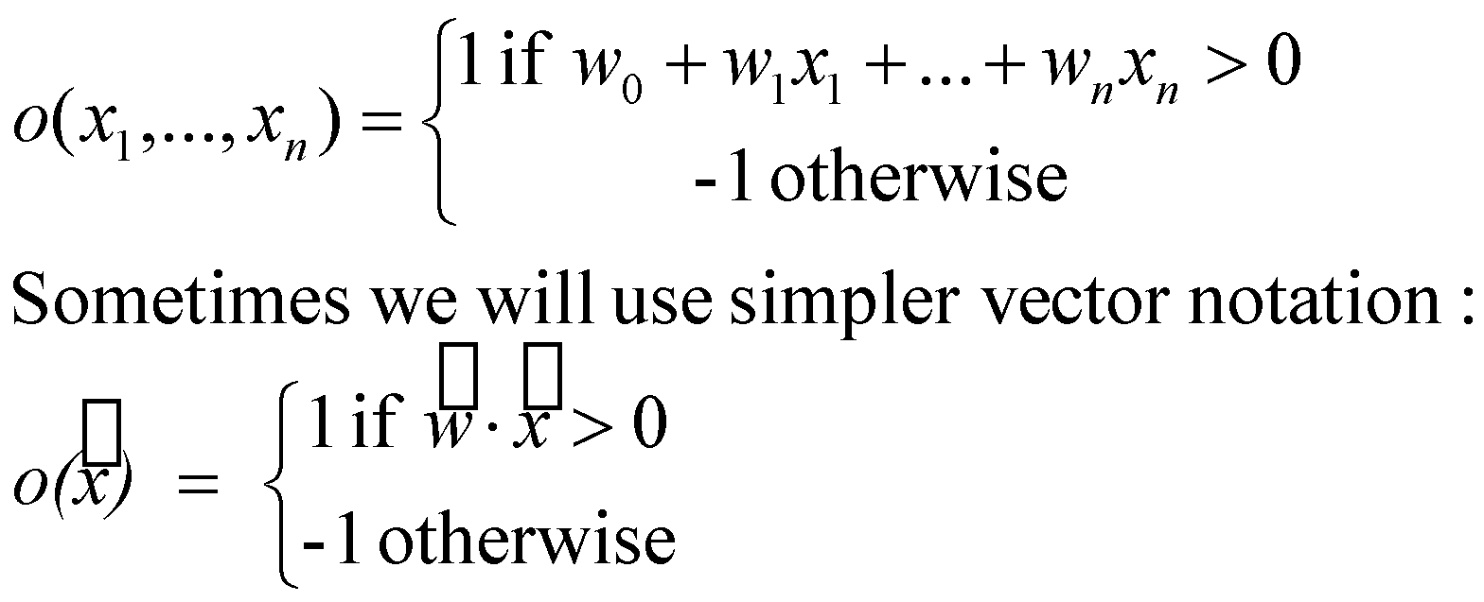
Perceptron
CS 521 Machine Learning
Chapter 4 Artificial Neural Networks
9

Slide 10

A perceptron takes a vector of real-valued inputs, calculates a linear combination of these inputs, then outputs a 1 if the result is greater than some
threshold and -1 otherwise
Learning a perceptron involves choosing values for the weights wo, . . . , w,.
Therefore, the space H of candidate hypotheses considered in perceptron learning is the set of all possible real-valued weight vectors

Slide 11
Decision Surface of Perceptron
Represents some useful functions
What weights represent g(x₁,x₂) = AND(x₁,x₂)?
But some functions not representable
e.g., not linearly separable
therefore, we will want networks of these …
multilayer networks of threshold units.
CS 521 Machine Learning
Chapter 4 Artificial Neural Networks
11

Slide 12
Represent a hyperplane decision surface in the
n-dimensional space of instances (i.e., points).
The perceptron outputs a 1 for instances lying on one side of the hyperplane and outputs a -1 for instances lying on the other side.
A single perceptron can be used to represent many boolean functions.
Ex:Use a two-input perceptron to implement the AND function is to set the weights wo = -0.8, and wl = w2 = 0.5.
For OR w0=-0.3 and wl = w2 = 0.5.

Slide 13
Perceptron Training Rule
The precise learning problem is to determine a weight vector that causes the perceptron to produce the correct f 1 output for each of the given training examples.
Several algorithms are known to solve this learning problem.
Here we consider two: the perceptron rule and the delta rule
These two algorithms are guaranteed to converge to somewhat different acceptable hypotheses, under somewhat different conditions.

Slide 14
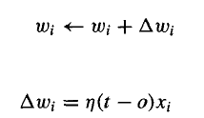
Perceptron Training Rule
Begin with random weights, then iteratively apply the perceptron to each training example, modifying the perceptron weights whenever it misclassifies an example.
This process is repeated, iterating through the training examples as many times as needed until
the perceptron classifies all training examples correctly.
Perceptron training rule

Slide 15
Perceptron Training Rule
Here t is the target output for the current training example, o is the output generated by the perceptron, and n is a positive constant called the learning rate.
The role of the learning rate is to moderate the degree to which weights are changed at each step.
The above learning procedure can be proven to converge provided the training examples are linearly separable and provided a sufficiently small n is used.
If the data are not linearly separable, convergence is not assured.
CS 521 Machine Learning
Chapter 4 Artificial Neural Networks
15

Slide 16
Delta Rule
If the training examples are not linearly separable, the delta rule converges toward a best-fit approximation to the target concept.
The key idea behind the delta rule is to use gradient descent to search the hypothesis space of possible weight vectors to find the weights that best fit the training examples.
In order to derive a weight learning rule for linear units, let us begin by specifying a measure for the training error of a hypothesis

Slide 17
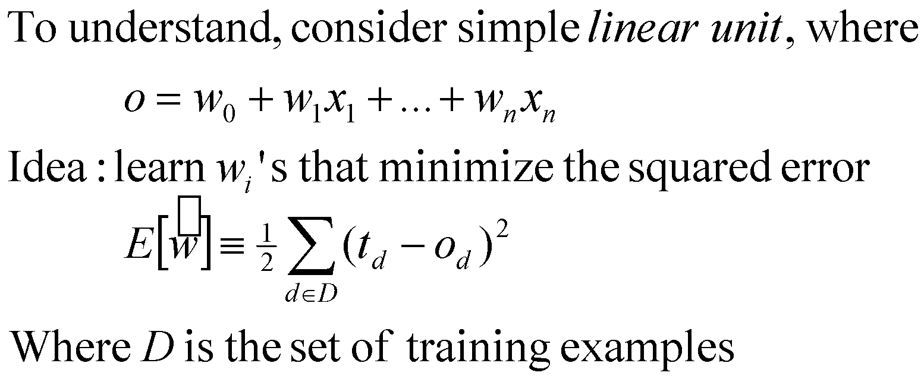
Gradient Descent
CS 521 Machine Learning
Chapter 4 Artificial Neural Networks
17

Slide 18
VISUALIZING THE HYPOTHESIS SPACE
Here the axes wo and wl represent possible values for the two weights of a simple linear unit.
The wo, wl plane therefore represents the entire hypothesis space.
The vertical axis indicates the error E relative to
some fixed set of training examples.
The error surface shown in the figure thus
summarizes the desirability of every weight vector in the hypothesis space
Error surface must always be parabolic with a single global minimum.

Slide 19
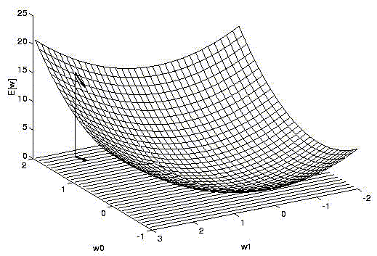
Gradient Descent
CS 521 Machine Learning
Chapter 4 Artificial Neural Networks
19

Slide 20
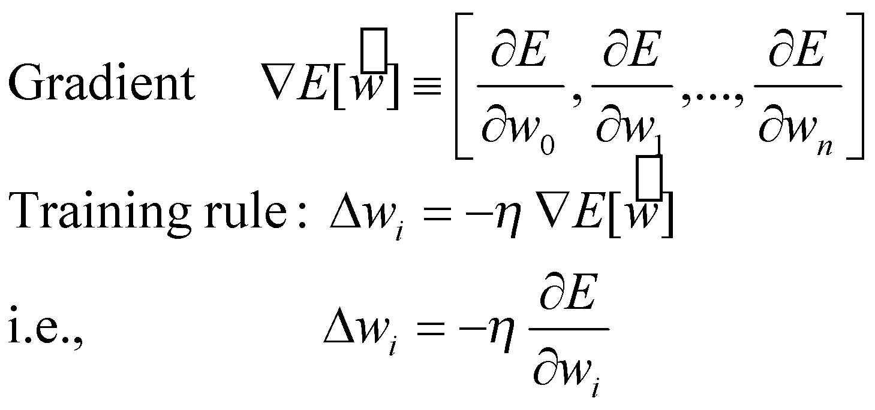
Direction can be found by computing the derivative of E with respect to each component of the vector w. This vector derivative is called the gradient of E with respect to vector w.

Slide 21
Gradient Descent
Here n is a positive constant called the learning rate, which determines the step size in the gradient descent search.
The negative sign is present because we want
to move the weight vector in the direction that decreases E.
We need an efficient way of calculating the gradient at each step.
Gradient can be obtained by differentiating E.
If n is too large, the gradient descent search runs the risk of overstepping the minimum in the error surface rather than settling into it.
CS 521 Machine Learning
Chapter 4 Artificial Neural Networks
21

Slide 22
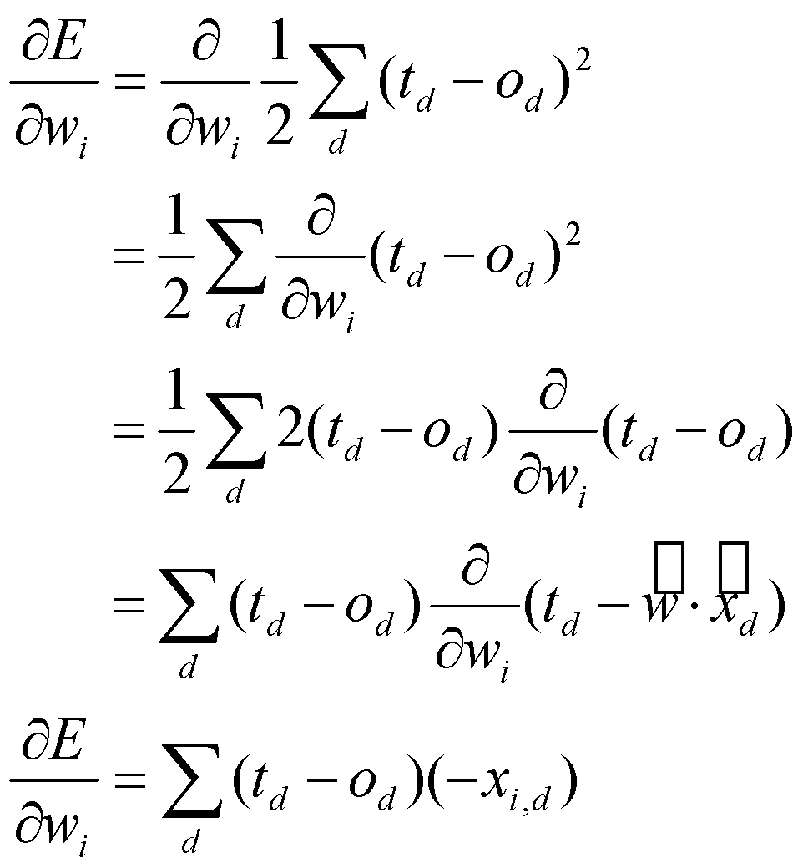
Gradient Descent
CS 521 Machine Learning
Chapter 4 Artificial Neural Networks
22

Slide 23
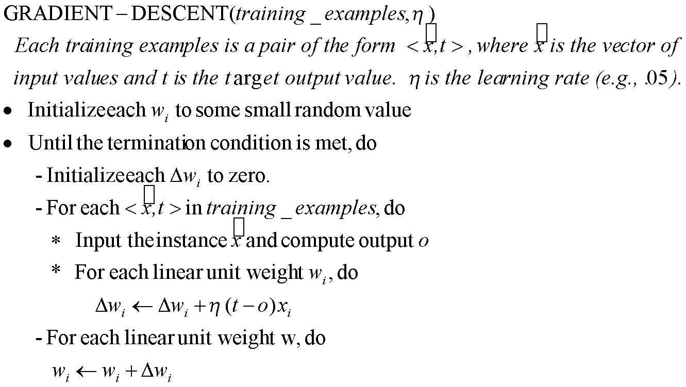
Gradient Descent
CS 521 Machine Learning
Chapter 4 Artificial Neural Networks
23

Slide 24
Summary
Perceptron training rule guaranteed to succeed if
Training examples are linearly separable
Sufficiently small learning rate η
Linear unit training rule uses gradient descent
Guaranteed to converge to hypothesis with minimum squared error
Given sufficiently small learning rate η
Even when training data contains noise
Even when training data not separable by H
CS 521 Machine Learning
Chapter 4 Artificial Neural Networks
24

Slide 25
The key practical difficulties in applying gradient
descent are
(1) converging to a local minimum can sometimes be quite slow
(2) if there are multiple local minima in the error surface, then there is no guarantee that the procedure will find the global minimum.
One common variation on gradient descent intended to alleviate these difficulties is called incremental gradient descent, or alternatively stochastic gradient descent.

Slide 26

The idea behind stochastic gradient descent is to approximate this gradient descent search by updating weights incrementally, following the calculation of the error for each individual example.
As we iterate through each training example we update the weight according to

Slide 27
Gradient descent and stochastic gradient descent
In standard gradient descent, the error is summed over all examples before updating weights, whereas in stochastic gradient descent weights are updated upon examining each training example
Standard gradient descent is often used with a larger step size per weight update than stochastic gradient descent.
Stochastic gradient descent can sometimes avoid falling into multiple local minima

Slide 28
Summary
Perceptron training ing rule updates weights based on the error in the thresholded perceptron output, whereas the delta rule updates weights based on the error in the unthresholded linear combination of inputs
A third possible algorithm for learning the weight vector is linear programming.
Linear programming is a general, efficient method for solving sets of linear inequalities.

Slide 29
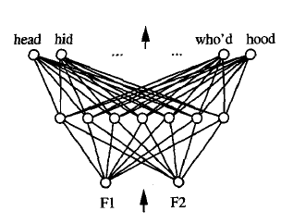
Multilayer Networks of Sigmoid Units
The kind of multilayer networks learned by the BACKPROPAGATION algorithm are capable of expressing a rich variety of nonlinear decision surfaces.
A typical multilayer network and decision surface is depicted in the figure.

Slide 30
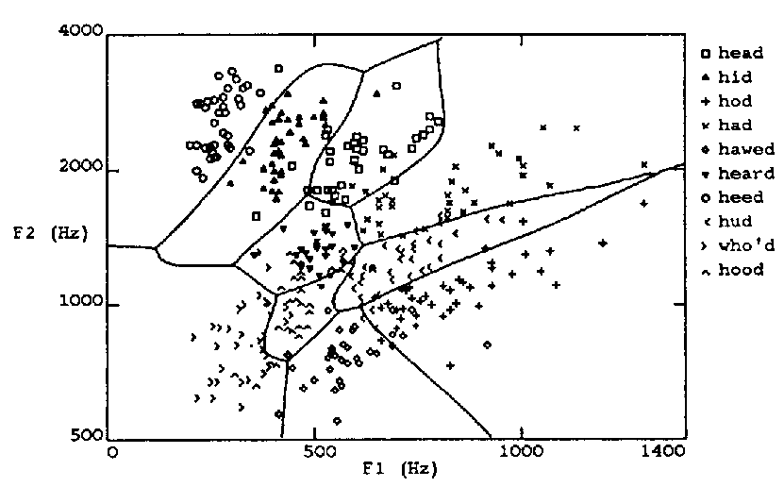
Multilayer Decision Space
CS 521 Machine Learning
Chapter 4 Artificial Neural Networks
30

Slide 31
The input speech signal is represented by two numerical parameters obtained from a spectral analysis of the sound, allowing us to easily visualize the decision surface over the two-dimensional instance space.
As shown in the figure, it is possible for the multilayer network to represent highly nonlinear
decision surfaces
Differential Threshold Unit:
Multiple layers of cascaded linear units still produce only linear functions.
Unit whose output is a nonlinear function of its inputs, but whose output is also a differentiable function of its inputs.
One solution is the sigmoid unit-a unit very much like a perceptron, but based on a smoothed, differentiable threshold function

Slide 32
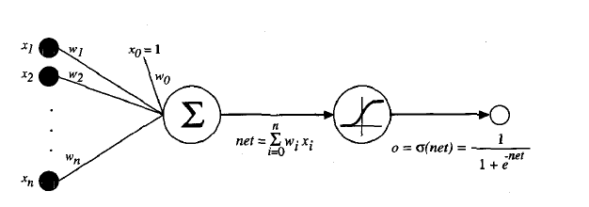

Slide 33


First computes a linear combination of its inputs, then applies a threshold to the result.
The sigmoid unit computes its output o as
Its output ranges between 0 and 1, increasing monotonically with its input .
It maps a very large input domain to a small range of outputs, it is often referred to as the squashing function of the unit.

Slide 34
The term e to the power of -y in the sigmoid function definition is sometimes replaced by e-k'y where k is some positive constant that determines
the steepness of the threshold.
The function tanh is also sometimes used in place
of the sigmoid function

Slide 35
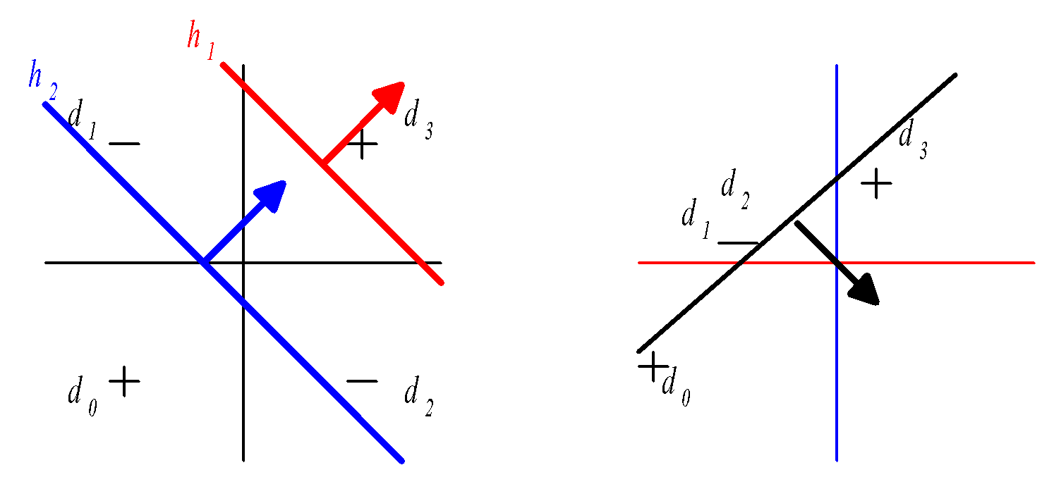
Multilayer Networks of Sigmoid Units
CS 521 Machine Learning
Chapter 4 Artificial Neural Networks
35

Slide 36
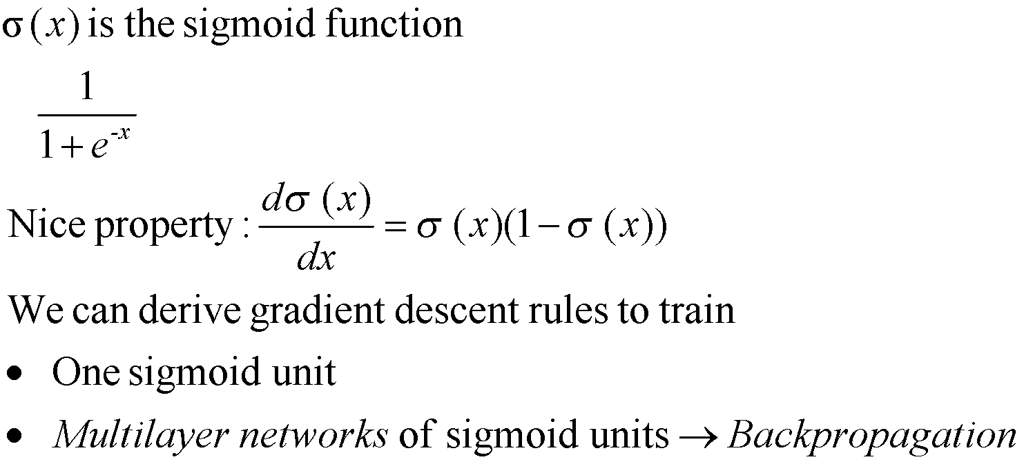
Sigmoid Unit
CS 521 Machine Learning
Chapter 4 Artificial Neural Networks
36

Slide 37
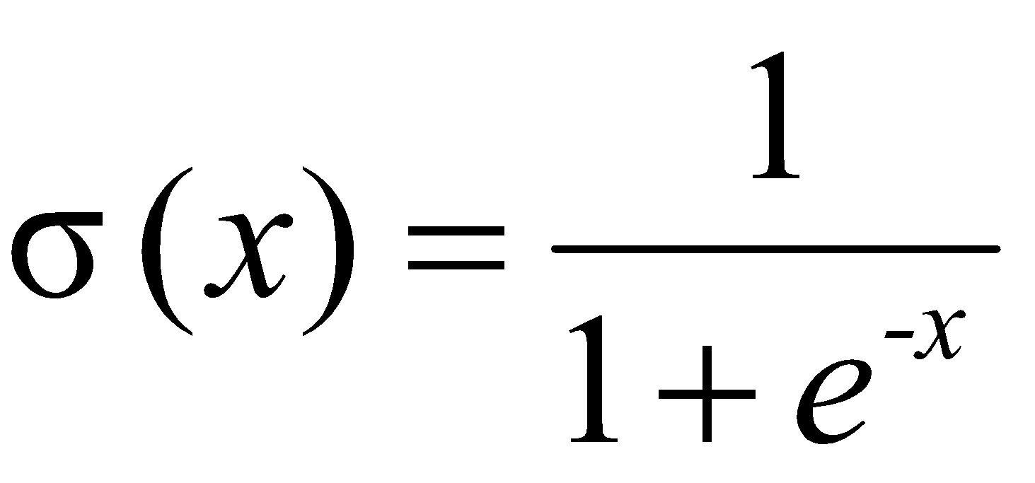
The Sigmoid Function
Sort of a rounded step function
Unlike step function, can take derivative (makes learning
possible)
CS 521 Machine Learning
Chapter 4 Artificial Neural Networks
37

Slide 38
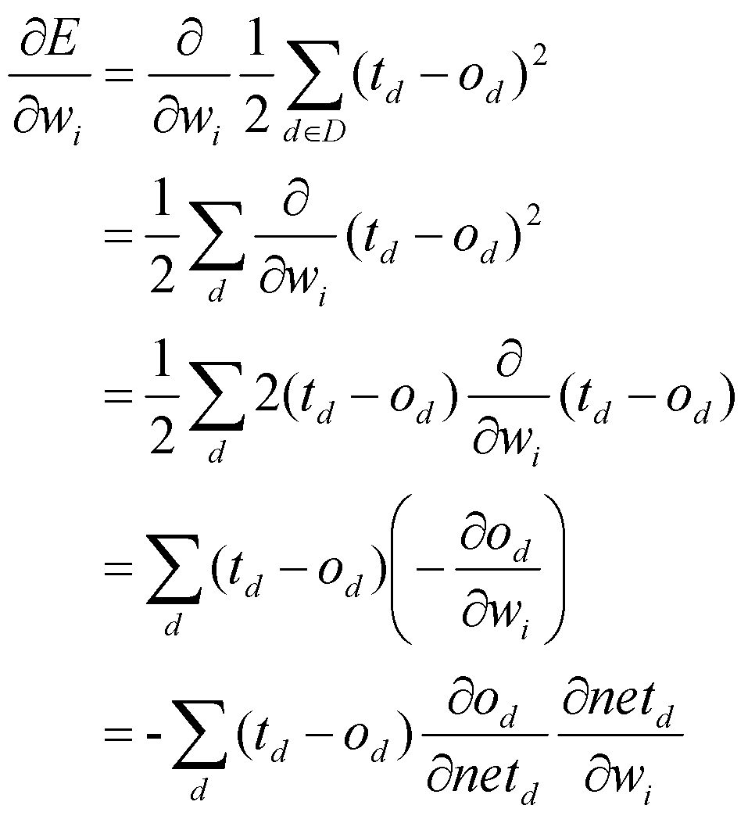
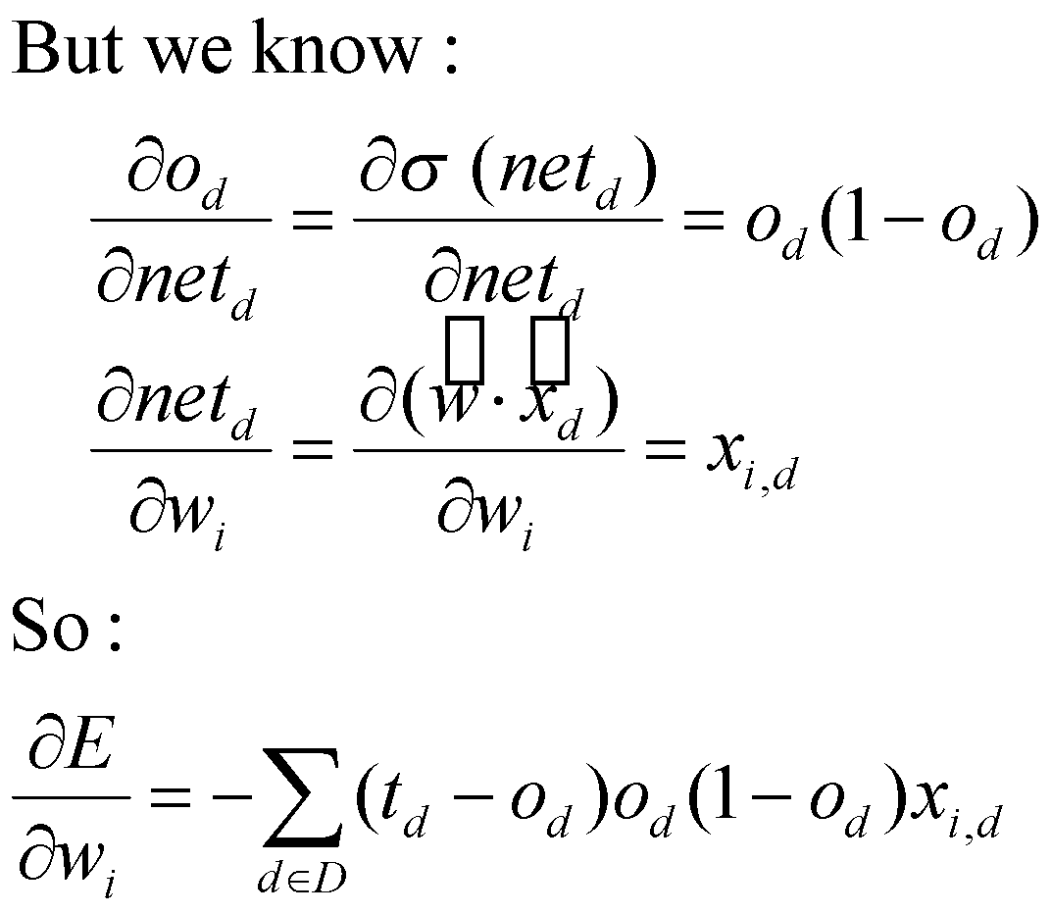
Error Gradient for a Sigmoid Unit
CS 521 Machine Learning
Chapter 4 Artificial Neural Networks
38

Slide 39
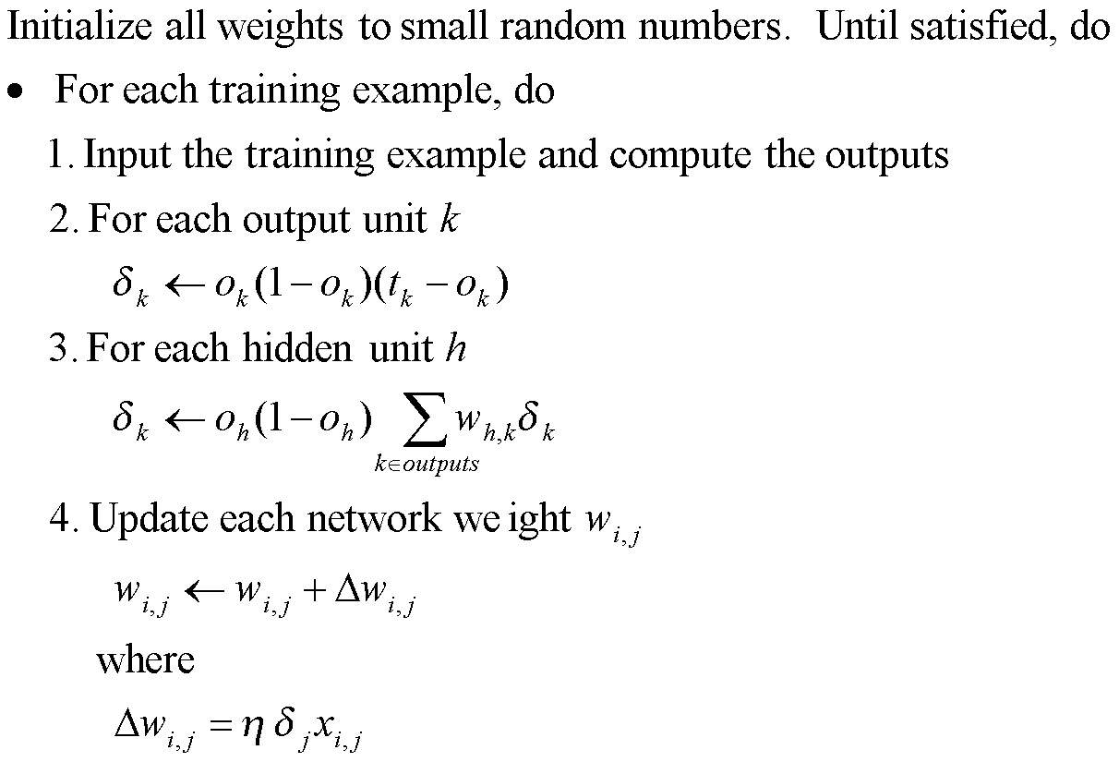
Backpropagation Algorithm
CS 521 Machine Learning
Chapter 4 Artificial Neural Networks
39

Slide 40
The algorithm as described here applies to layered feedforward networks containing two layers of sigmoid units
An index (e.g., an integer) is assigned to each node in the network,where a "node" is either an input to the network or the output of some unit in thenetwork.
xji denotes the input from node i to unit j , and wji denotes the corresponding weight.
σn, denotes the error term associated with unit n.

Slide 41
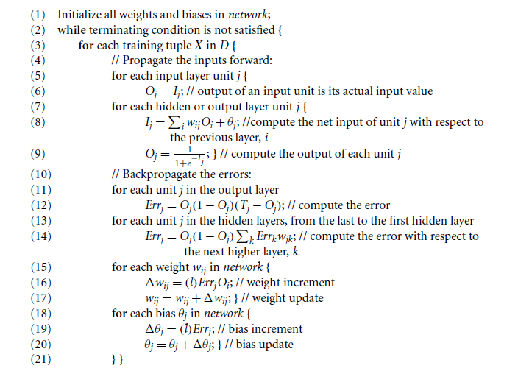

Slide 42
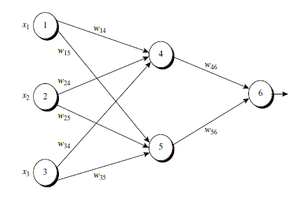
Example

Slide 43
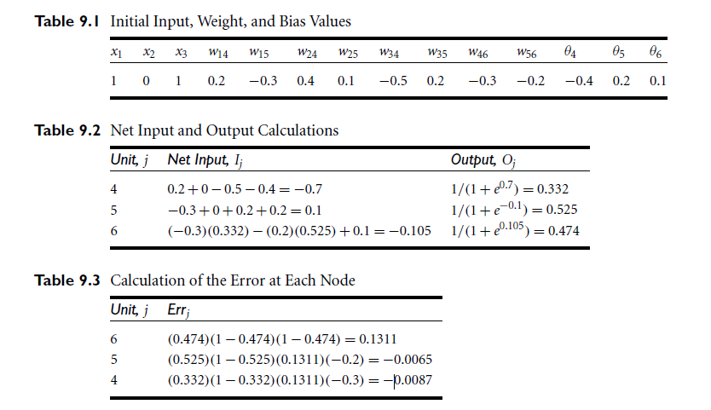

Slide 44
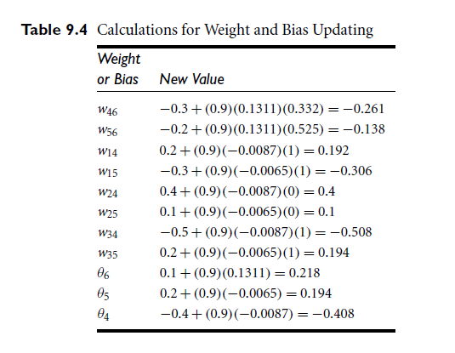

Slide 45
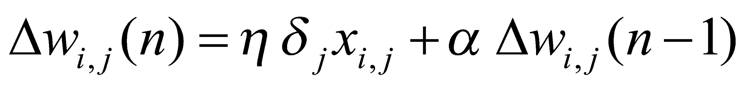
More on Backpropagation
Gradient descent over entire network weight vector
Easily generalized to arbitrary directed graphs
Will find a local, not necessarily global error minimum
In practice, often works well (can run multiple times)
Often include weight momentum α (0 <= α < 1)
Minimizes error over training examples
Will it generalize well to subsequent examples?
Training can take thousands of iterations -- slow!
Using network after training is fast
CS 521 Machine Learning
Chapter 4 Artificial Neural Networks
45

Slide 46

Learning in arbitrary acyclic networks
The algorithm given there easily generalizes to feedforward networks of arbitrary depth.
In general, the σr, value for a unit r in layer m is computed from the σ values at the next deeper layer m+ 1 according to

Slide 47


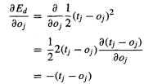
Derivation of the BACKPROPAGATION Rule
Case 1: Training Rule for Output Unit Weights:
netj, can influence the network only through oj.

Slide 48



Contd…

Slide 49
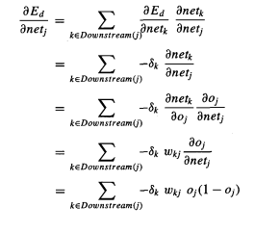

Contd..
Case 2: Training Rule for Hidden Unit Weights
Downstream( j):the set of all units immediately downstream of unit j in the network

